Slide 1
Computer Network (CS3002)
Spring Semester (2021-2022)
Dr. Judhistir Mahapatro
Department of Computer Science and Engineering
National Institute of Technology Rourkela

Slide 2
The Medium Access Control Sublayer

Slide 3
CSMA with Collision Detection
Main idea
  Persistent and Nonpersistent CSMA protocols are better than ALOHA
    No station begin to transmit if channel is busy
  Another improvement is for stations to quickly detect the collision and abruptly stop transmitting.
    Save time and bandwidth
CSMA/CD is the basis of the classic Ethernet LAN
Collision detection is an analog process
Stations hardware must listen to the channel while it is transmitting

Slide 4
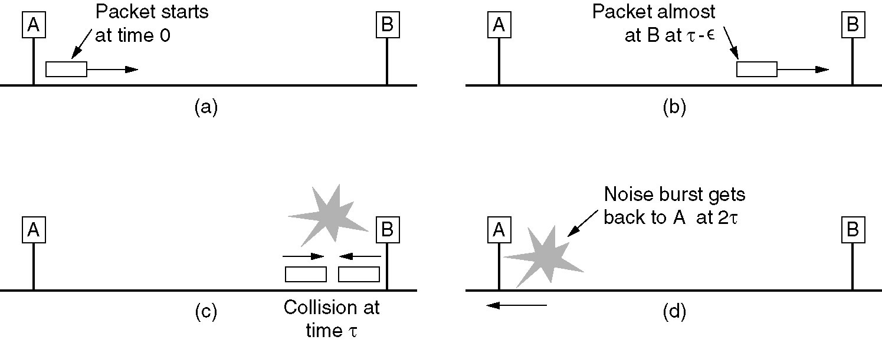

Slide 5
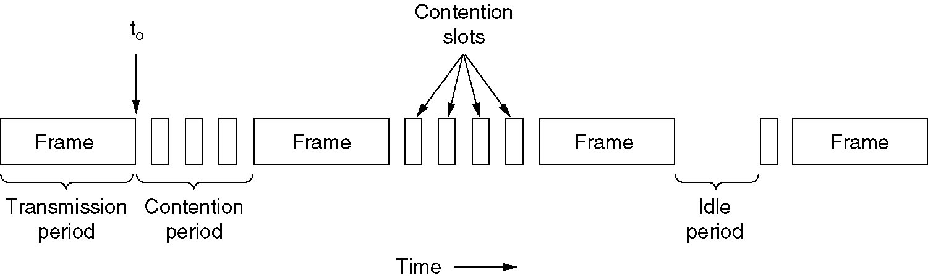
Illustration of CSMA/CD
CSMA/CD can be in one of three states: contention, transmission, or idle.

Slide 6
Design Issues
The maximum propagation delay
  E.g. about 5us to transmit signal through 1 km long co-axial cable
  Data transmission rate is 10 Mbps, minimum packet is 512 bits or 64 bytes
The capability to distinguish two signals from different stations
  This is an analogue process
CSMA/CD system is half-duplex

Slide 7
Multiple Access Protocols
ALOHA
Carrier Sense Multiple Access Protocols
Collision-Free Protocols
Limited-Contention Protocols
Wireless LAN Protocols

Slide 8
Collision-Free Protocols
Still collisions occur during the contention period of CSMA/CD
These collisions adversely affect the system performance,
  when the cable is long (i.e., large τ)
  Short frame

Slide 9
Collision-Free Protocols
Protocols that resolve the contention for the channel without any collisions at all, not even during the contention period.
Assume that Propagation delay is negligible.

Slide 10
The Basic Bit-Map Protocol
Suppose there are N stations in the network
  There are N slots in the contention period
    Bit map
  In each slot, a “0” means that the station has no frame to send; a “1” means that the station has a frame to send
All stations have the knowledge of which stations wish to transmit at the end of contention period
Reservation protocols
  Protocols in which the desire to transmit is broadcast before the actual transmission

Slide 11
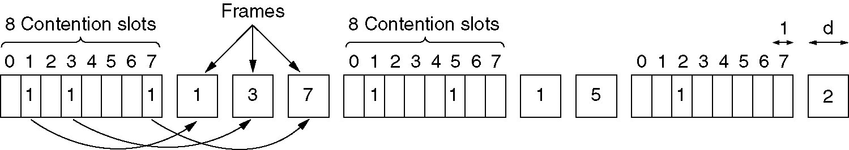
The Basic Bit-Map Protocol

Slide 12
Pros and Cons
Pros
  No collision or contention
Cons
  Access delay
    One station shall wait for the next contention period if it miss the current one
  Overhead
    Bit map shall be sent even if there is no frame to be sent
    Scalability issue
Conditions
  Global synchronization

Slide 13
The Binary Countdown Protocol
The problem of the basic bit-map protocol
  Each station need one bit in the bit-map
    Not scalable

Slide 14
The Binary Countdown Protocol
Binary countdown
  Main idea
    A station wanting to use the channel can broadcast its address as a binary bit string, starting with the high-order bit
  Rule
    A station will stop transmitting if it sees that a high-order bit position that is 0 in its address has been overwritten with a 1
    BOOLEAN ORed by the channel

Slide 15
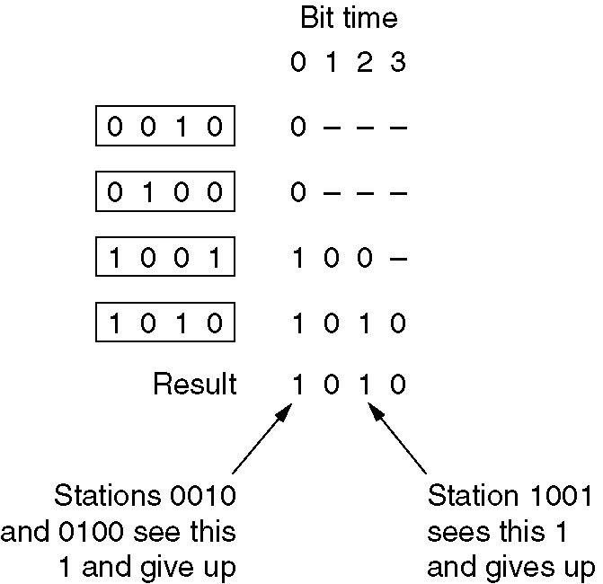
The Binary Countdown Protocol

Slide 16
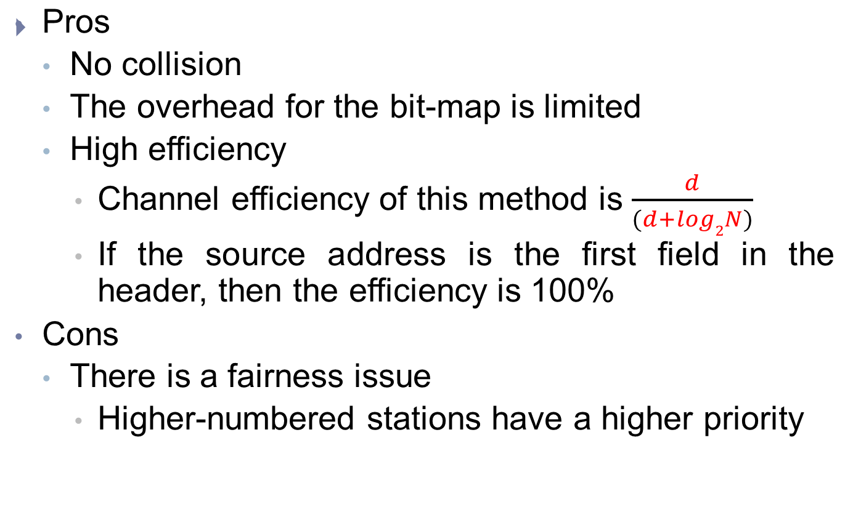
Pros and Cons

Slide 17
Token Bus
Token Bus is described in the IEEE 802.4 specification, and is a Local Area Network (LAN)
  The stations on the bus form a logical ring.
Each station is assigned a place in an ordered sequence
  with the last station in the sequence being followed by the first.
Each station knows the address of the station to its "left" and "right" in the sequence.

Slide 18
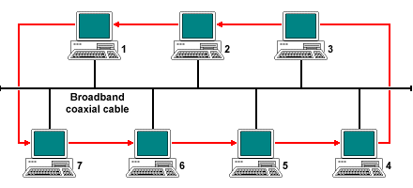
Token Bus

Slide 19
Token Bus
It employs a small data frame
  Only a few bytes in size, known as a token,
  To grant individual stations exclusive access to the medium.
The token frame carries the destination address of the next station in the logical sequence.
Each station takes turns to transmit a frame
  If there are n stations, and each takes T seconds to send a frame, no station has to wait longer than nT seconds to acquire the token.

Slide 20
The Token Bus MAC layer protocol
When the ring is initialized, token is inserted into it in station address order, starting with the highest.
The token itself is passed from higher to lower addresses.
Once a station acquires the token, it has a fixed time period during which it may transmit frames
If a station has no data to send, it simply passes the token to the next station without delay.

Slide 21
The Token Bus MAC layer protocol
The Token Bus standard defines four classes of priority for traffic – 0 (lowest), 2, 4, and 6 (highest)
Each station maintains four internal queues that correspond to the four priority levels.

Slide 22
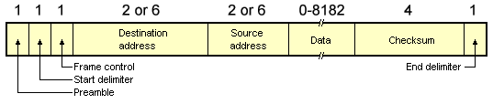
The Token Bus MAC layer protocol
The Preamble field is used to synchronise the receiver's clock.
The Start Delimeter and End Delimeter fields are used to mark the start and end of the frame,
    contain an analogue encoding of symbols other than 0s and 1s
    For this reason, a length field is not required.

Slide 23
The Token Bus MAC layer protocol
Frame control field specifies the type of frame.
    It distinguishes data frame from control frames.
  For data frames, it carries frame's priority.
  For control frames, it specifies the frame type.
    token passing and
    various ring maintenance frames
      Including the mechanism for letting new station enter the ring,
      The mechanism for allowing stations to leave the ring.

Slide 24
The Token Bus MAC layer protocol
Destination address
  It specifies 2 to 6 bytes destination address.
Source address
  It specifies 2 to 6 bytes source address.

Slide 25
The Token Bus MAC layer protocol
Data
    This field may be upto 8182 bytes long when 2 bytes addresses are used
    upto 8174 bytes long when 6 bytes address is used.
Checksum
  This 4 byte field detects transmission errors.

Slide 26
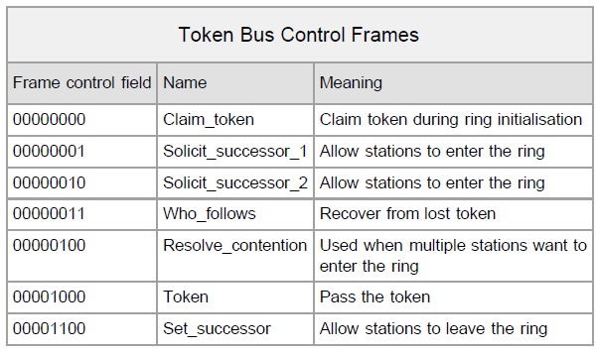
The Token Bus MAC layer protocol

Slide 27
The Token Bus MAC layer protocol
Periodically, a station will transmit a SOLICIT_SUCCESSOR frame to solicit bids from stations wishing to join the ring.
  The frame includes the sender's address, and that of its current successor in the ring.
Only stations with an address falling between these two addresses may bid to enter the ring.
If no station bids to enter within a slot time, and the token holder returns to its normal business.

Slide 28
The Token Bus MAC layer protocol
If only one station bids to enter, it is inserted into the ring and becomes the token holder's successor.
If two or more stations bid to enter, their frames will collide.
  The token holder then runs an arbitration process, that begins with the broadcast of a RESOLVE_CONTENTION frame.
  The algorithm is a variation of binary countdown, using two bits at a time.

Slide 29
The Token Bus MAC layer protocol
To leave the ring,
  A station X with a predecessor P and a successor S
    It simply sends a SET_SUCCESSOR frame to P telling it that from now on its successor is S.
  Station X then just stops transmitting.

Slide 30
The Token Bus MAC layer protocol
Ring initialization is a special case of adding new stations.
  When the first station comes on line, it then broadcasts a CLAIM_TOKEN frame.
    Not receiving a reply, it creates a token and sets up a ring, and periodically solicits bids for new stations.
    New stations join the ring, if necessary using the contention algorithm described above.
  If the first two stations are powered on simultaneously,
    They bid for the token using standard modified binary countdown algorithm and two random bits.

Slide 31
The Token Bus MAC layer protocol
Problems that a station tries to pass a token to a station which has been taken offline.
  monitors to determine whether its successor has transmitted a frame or passed the token.
  If none occurred, it generates a second token.
  If that also fails, the station transmits a WHO_FOLLOWS frame specifying the address of its successor.
  When the failed station's successor sees a WHO_FOLLOWS frame naming its predecessor, it responds with a SET_SUCCESSOR frame, naming itself as the new successor.
  The failed station is then removed from the ring.

Slide 32
The Token Bus MAC layer protocol
If two consecutive stations go offline
  the WHO_FOLLOWS frame will fail to get a response.
  the station sends a SOLICIT_SUCCESSOR_2 frame to see if any other stations are still active.
The standard connection protocol is run once again, with all active stations bidding for a place until the ring is reestablished.

Slide 33
The Token Bus MAC layer protocol
if the token holder goes down and takes the frame with it.
  the ring initialization algorithm is used to reestablish the ring.

Slide 34
The Token Bus MAC layer protocol
Multiple tokens on the ring are another problem
  if a station currently holding a token notices a transmission from another station, it discards its token.
  This process is repeated until all but one of the tokens are discarded.
  If all of the tokens are discarded by accident, the lack of activity will cause one or more of the stations to try and claim the token.

Slide 35
Token Ring (IEEE LAN Standard 802.5)
IEEE 802.5 networks are basically compatible with Token Ring
Token Ring network specifies a star, with all end stations attached to a device called a multi-station access unit (MSAU).
  In contrast, IEEE 802.5 does not specify a topology
Token Ring including media type (twisted-pair wire)
  IEEE 802.5 does not specify a media type

Slide 36
Physical Connections
Token Ring network stations are directly connected to MSAUs, which can be wired together to form one large ring.
MSAUs include bypass relays for removing stations from the ring.

Slide 37
Token Ring Operation
Move a small frame, called a token, around the network.
  Possession of the token grants the right to transmit.
  If a node has no information to send, it passes the token to the next end station.
  Station can hold the token for a maximum period of allowed time.

Slide 38
Token Ring Operation
If a station with the token does have information to transmit
  Alters 1 bit of the token, appends the information, and sends this information to the next station on the ring.
While the information frame is circling the ring
  no token is on the network, which means that other stations wanting to transmit must wait.
  Collisions cannot occur in Token Ring networks.

Slide 39
Token Ring Operation
If early token release is supported,
  a new token can be released when frame transmission is complete.

Slide 40
Token Ring Operation
The information frame circulates the ring until it reaches the intended destination station, which copies the information for further processing.
The information frame continues to circle the ring and is finally removed when it reaches the sending station.
The sending station can check the returning frame to see whether the frame was seen and subsequently copied by the destination.

Slide 41
Token Ring Operation
Unlike CSMA/CD networks (such as Ethernet), token-passing networks are deterministic
  It is possible to calculate the maximum time that will pass before any end station will be capable of transmitting.
This feature and several reliability features make Token Ring networks ideal for applications in which delay must be predictable and robust network operation is important.

Slide 42
Priority System
Token Ring networks use a sophisticated priority system that permits certain user-designated, high-priority stations to use the network more frequently.
Token Ring frames have two fields that control priority: the priority field and the reservation field.
Only stations with a priority equal to or higher than the priority value contained in a token can seize that token.

Slide 43
Priority System
After the token is seized and changed to an information frame,
  only stations with a priority value higher than that of the transmitting station can reserve the token for the next pass around the network.
When the next token is generated, it includes the higher priority of the reserving station.
Stations that raise a token's priority level must reinstate the previous priority after their transmission is complete.

Slide 44
Fault-Management Mechanisms
Employ several mechanisms for detecting and compensating for network faults.
  For example, one station is selected to be the active monitor, which acts as a centralized source and performs a variety of ring-maintenance functions.
      On event of sending device failure
      The active monitor can detect such frames, remove them from the ring, and generate a new token.

Slide 45
Frame Format
Token Ring and IEEE 802.5 support two basic frame types: tokens and data frames.
Tokens are 3 bytes in length and consist of a start delimiter, an access control byte, and an end delimiter.
Data frames vary in size, depending on the size of the Information field.
  Data frames carry information for upper-layer protocols, while command frames contain control

Slide 46
Token Frame Fields
1 byte
1 byte
1 byte
Start
Delimiter
Access Control
End Delimiter
P | P | P | T | M | R | R | R

Slide 47
Token Frame Fields
Start delimiter
    Alerts each station of the arrival of a token (or data frame).
    This field includes signals that distinguish the byte from the rest of the frame.
Access-control byte
    Contains the Priority field (the most significant 3 bits) and the Reservation field (the least significant 3 bits), as well as a token bit and a monitor bit
  End delimiter
    Signals the end of the token or data frame.

Slide 48
Access-control byte
T=Token
T = 0 for Token
T = 1 for Frame

Slide 49
Access-control byte
P = Priority
  Priority Bits indicate tokens priority.
  Station can transmit if its priority as at least as high as that of the token.
Priority field | Description
0 0 0 | Normal data traffic
0 0 1 | Not used
0 1 0 | Not used
0 1 1 | Not used
1 0 0 | Normal data traffic (forwarded from other devices)
1 0 1 | Data sent with time sensitivity requirements.
1 1 0 | Data with real time sensitivity (VOIP)
1 1 1 | Station management

Slide 50
Access-control byte
M = Monitor
  Prevent a token whose priority is greater than 0 or any frame from continuously circulating on the ring.
  If an active monitor detects a frame or a high priority token with M is set to 1, the frame or token is aborted.
  This bit shall be transmitted as 0 in all frame and tokens.
  The active monitor inspects and modifies this bit.
    All other stations shall repeat this bit as received.

Slide 51
Access-control byte
R = Reserved bits
  The reserved bits allow station with high priority Frames to request that the next token be issued at the requested priority

Slide 52
Data Frame Fields
1
1
1
2 or 6
2 or 6
0-4500
4
1
1
Frame Control
Frame Status
SD
AC
DA
SA
Data
FCS
ED

Slide 53
Data Frame Fields
Frame-control bytes
  Indicates whether the frame contains data or control information.
  In control frames, this byte specifies the type of control information.
0-1 | 2-7
Frame type | Control bits
0 1 – LLC frame IEEE 802.2 (data) and ignore control bits
0 0 – MAC frame and control bits indicate the type of MAC control frame

Slide 54
Data Frame Fields
Destination and source addresses
  Consists of two 6-byte address fields that identify the destination and source station addresses.
Data
  Indicates that the length of field is limited by the ring token holding time, which defines the maximum time a station can hold the token.

Slide 55
Data Frame Fields
Frame-check sequence (FCS)
  A calculated value dependent on the frame contents.
  The destination station recalculates the value to determine whether the frame was damaged in transit. If so, the frame is discarded.
End Delimiter
  Signals the end of the token or data frame.
  The end delimiter also contains bits to indicate a damaged frame and identify the frame that is the last in a logical sequence.

Slide 56
Data Frame Fields
Frame Status
    a 1-byte field terminating a data frame. The Frame Status field includes the address-recognized indicator and frame copied indicator.
A
C
0
0
A
C
0
0
A = 1 Address recognized
C = 1 Frame Copied

Slide 57
Multiple Access Protocols
ALOHA
Carrier Sense Multiple Access Protocols
Collision-Free Protocols
Limited-Contention Protocols
Wireless LAN Protocols

Slide 58
A Trade-off
Two basic approaches
  Collision: Aloha, CSMA
  Collision-free
At low load, allowing collision can reduce the delay
At high load, collision free protocols can lead to better efficiency
Motivation
  To combine the good feature of these two protocols together

Slide 59
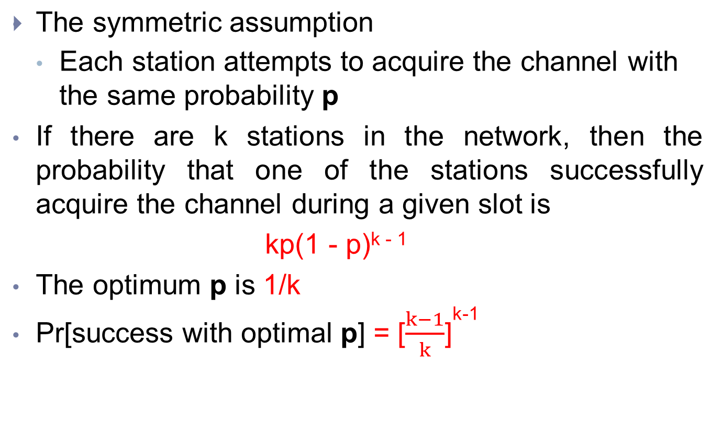
Optimum Transmission Probability

Slide 60
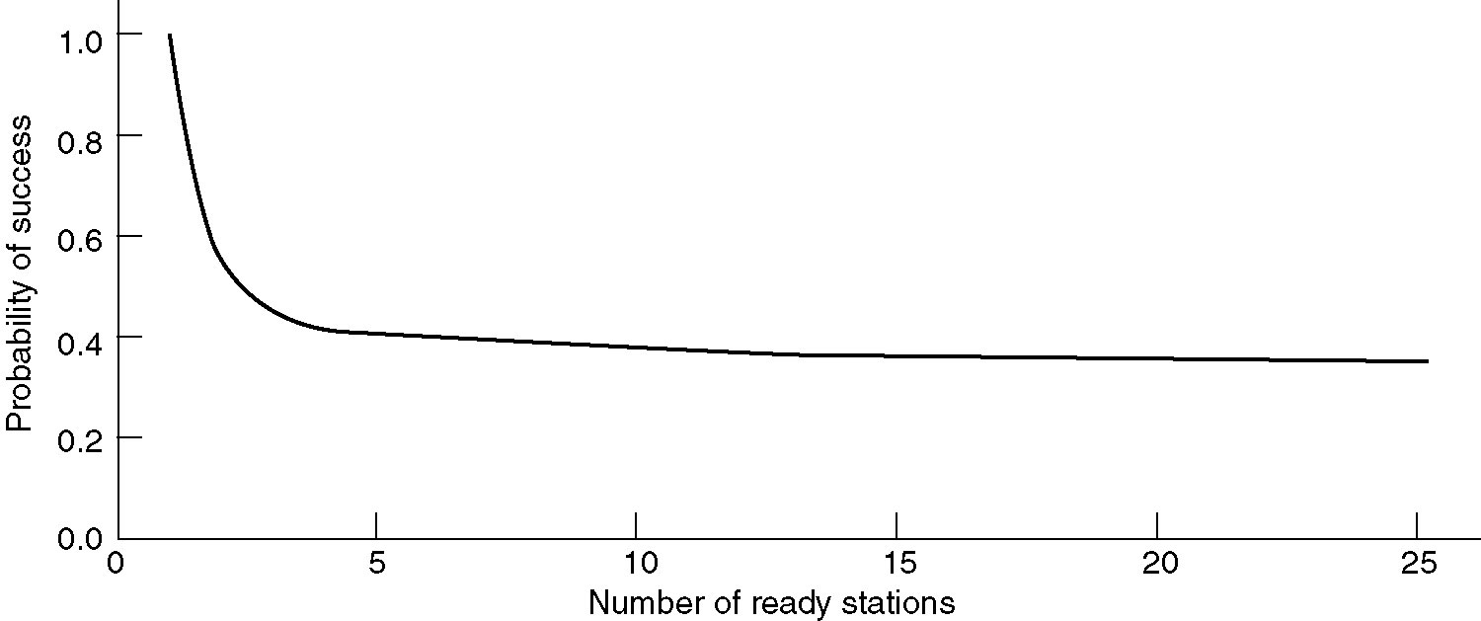
Limited-Contention Protocols
Acquisition probability for a symmetric contention channel

Slide 61
A Possible Approach
Divide the stations into groups, with index as 0, 1, …
Only the members of group 0 are permitted to compete for slot 0
Only the members of group 1 are permitted to compete for slot 1

Slide 62
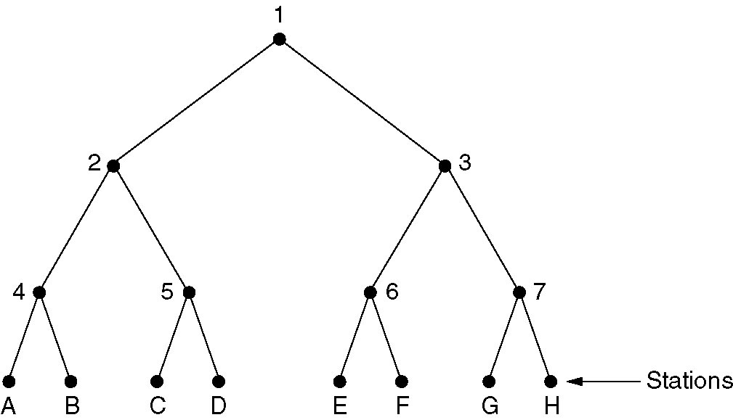
Adaptive Tree Walk Protocol
The tree for eight stations.

Slide 63
Adaptive Tree Walk Protocol
Construct a tree and all stations are leafs
Following a successful frame transmission, in the first contention slot, denoted as slot 0, all stations are permitted to try to acquire the channel
  If no collision, then continue
  If there is a collision, then during slot 1 only children of node 2 may compete
    If one of them acquires the channel, the slot following the frame is reserved for children of node 3
    If a collision occurs during slot 1, then only children of node 4 may compete in slot 2

Slide 64
Ethernet
Two kinds of Ethernet exists
  Classic Ethernet
    Original form and ran at rates from 3 to 10 Mbps.
  Switched Ethernet
    Switches are used to connect different computers
    Runs at 100 Mbps (fast Ethernet), 1000 Mbps (gigabit Ethernet), and 10, 000 Mbps (10 gigabit Ethernet)

Slide 65
Classic Ethernet
Designed and implemented the first Local Area Network by Metcalfe and Boggs, 1976 at Xerox PARC (Palo Alto Research Center)
  A single long, thick coaxial cable and ran at 3 Mbps
DEC, Intel and Xerox drew up a standard in 1978 for a 10-Mbps Ethernet
  DIX standard.

Slide 66
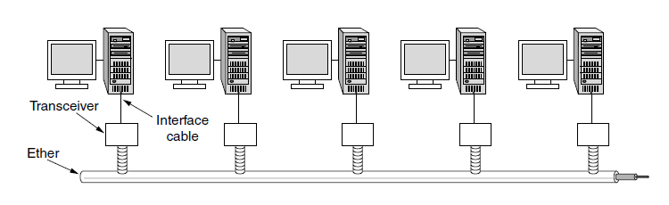
Architecture of Classic Ethernet
The first variety, popularly called thick Ethernet
  A single long cable
  Marking every 2.5 meters to connect computers.

Slide 67
Architecture of Classic Ethernet
thin Ethernet
    Bent more easily
    Made connections using industry-standard BNC (Bayonet Neill Concelman) connectors.
    Much cheaper and easier to install
    It could run for only 185 meters per segment (instead of 500 meter with thick Ethernet)
      Each can handle only 30 (instead 100)
    Multiple cables can be connected by repeaters (amplifies the signal)
    Over these cables, information sent using Manchester encoding.

Slide 68
Architecture of Classic Ethernet
  Over these cables, information sent using Manchester encoding.
  No two transceivers could be more than 2.5 km apart
  No path between any two transceivers could traverse more than four repeaters.

Slide 69
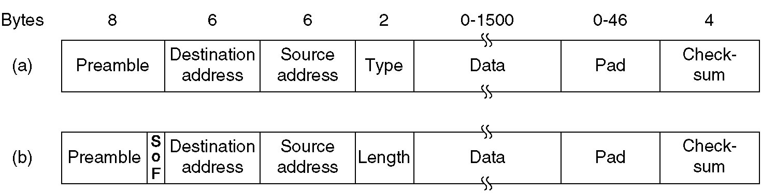
Frame Formats
(a) Original DIX Ethernet
    DIX=DEC, Intel, Xerox
(b) IEEE 802.3

Slide 70
Frame Formats
Preamble
  To allow the receiver to adjust its clock to synchronize with the sender's
  Pattern: 10101010 repeat 8 times (7 for the IEEE standard)
    The last two bits are set to 11 (to tell rest of the frame is about to start)
    Date rate = 10Mb/s or 10-MHz square wave
    Preamble time = 6.4us

Slide 71
Frame Formats
Address
  6-byte in most cases
  First bit of the destination address is 0 then ordinary address, otherwise group address
  Unicast: the first bit is 0
  Multicast: A group of stations listen to a single address.
    Sending to a group of stations is called multicasting.
  Broadcast: destination address is all 1s

Slide 72
Frame Formats
Type (DIX) / Length (IEEE 802.3)
  DIX: To indicate the upper layer (network)
Payload
  Max: 1500 bytes
    Limited by the RAM size
  Min: 46 bytes
    Through padding
    The total size of the frame must be at least 64 bytes
    The transmission time of the minimum frame must be larger than the maximum round-trip delay between two stations
      64*8*100ns=51.2us
      51.2us*200m/us=10 km (distance between two points)

Slide 73
Frame Formats
Checksum
    32-bit CRC

Slide 74
MAC Protocol

Slide 75
The Binary Exponential Backoff Algorithm
Purpose
    Randomization process when a collision occurs
Slot: 51.2us
    Worst-case round-trip propagation delay

Slide 76
The Binary Exponential Backoff Algorithm
Procedure
    After the first collision, each station waits either 0 or 1 slot times before trying again
    After the second collision, each one picks either 0, 1, 2, or 3 at random and waits that number of slot times
    …
    After the k^{th} collision, each station choose 0~2^{k}-1 slots, if k < 10
    If k>=10, each station randomly choose 0~1023 slots to defer its transmission

Slide 77
Ethernet Performance
Assumption
  k stations always ready to transmit (heavy and constant load)
  A constant retransmission probability in each slot
Each station transmits during a contention slot with probability p
  The probability of successful transmission is
    A=kp(1-p)^{k-1}
      k is the number of nodes in the network
    Optimum p=1/k
    Optimum A=1/e as k -> infinity

Slide 78
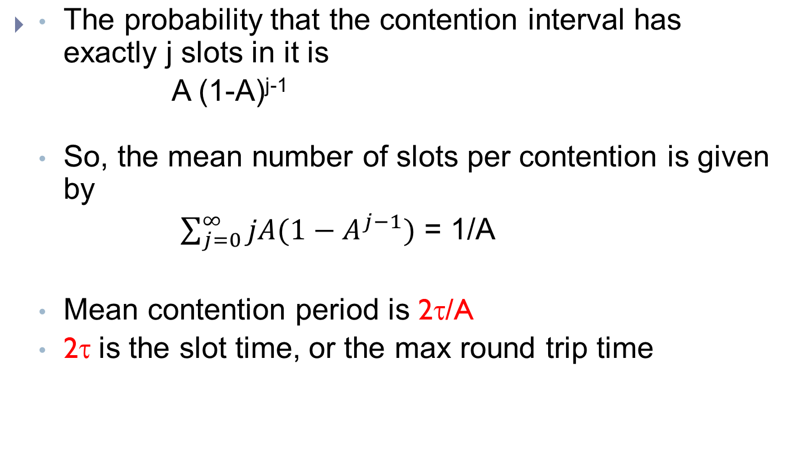
Ethernet Performance

Slide 79
Ethernet Performance
  Channel efficiency
    P/(P+ 2τ/A)
      P is the mean frame transmission time

Slide 80
Ethernet Performance
In term of frame length, F, the network bandwidth, B, the cable length, L, and the speed of signal propagation, c, for the optimal case of e contention slots per frame, with P=F/B,
Channel efficiency = 1/(1+2BLe/cF)

Slide 81
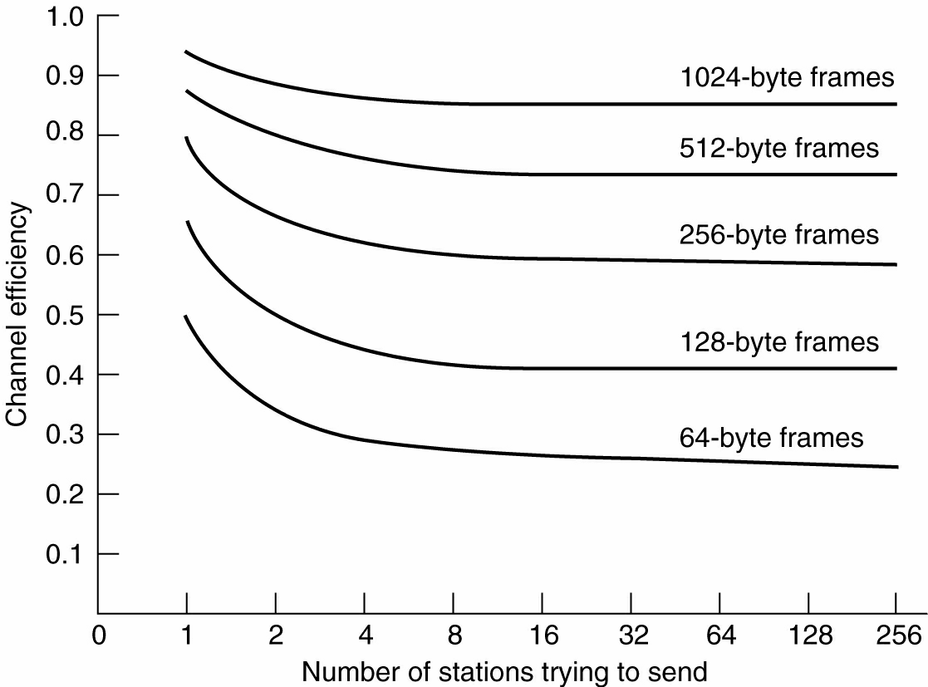
Impact of Number of Nodes and Frame Size

Slide 82
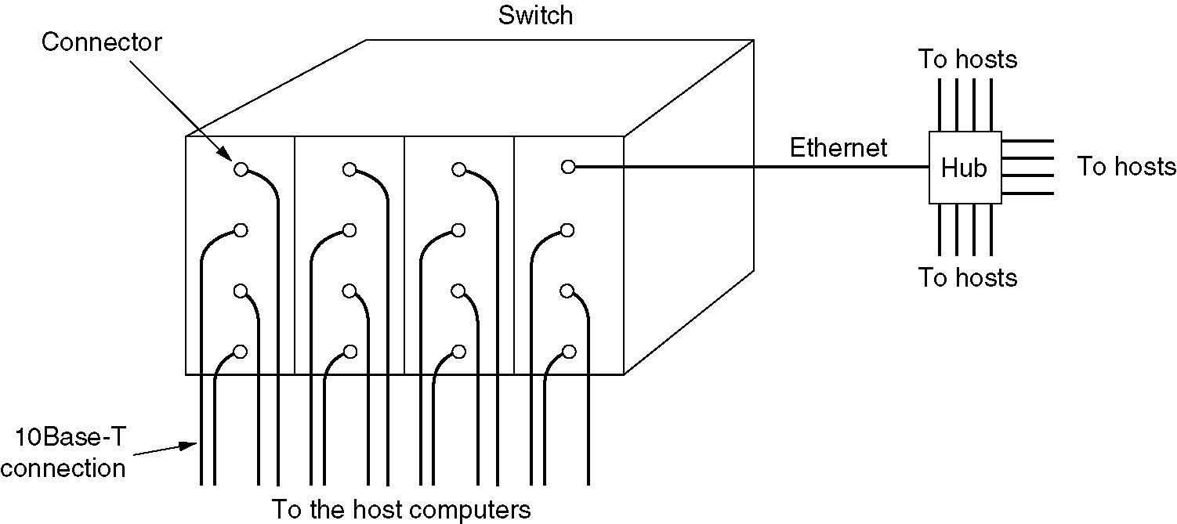
Switched Ethernet
A simple example of switched Ethernet.

Slide 83
Hub and Switch
Port
Port
Line
Line
Hub
Switch

Slide 84
Hub
A hub simply connects all the attached wires electrically, as if they were soldered together.
  Logically equivalent to the single long cable of classic Ethernet.
  Does not increase the capacity
  As more and more stations are added, each station gets a decreasing share of the fixed capacity.

Slide 85
Hub
Advantages
  Adding and removing station is simpler
  Cable breaks can be detected easily
  Use existing wiring and maintenance

Slide 86
Switched Ethernet
Switched Ethernet is an another way to deal with increased load.
  4 to 48 ports
  RJ-45 connector for a twisted-pair cable
  Switches only output frames to the ports for which those frames are destined.
  Which ports corresponds to which address.

Slide 87
Switched Ethernet
In a hub, all stations are in same collision domain.
  CSMA/CD is required
In a Switch, each port is its own independent collision domain
  CSMA/CD is not required (full duplex)
  Multiple frames can be sent simultaneously (by different stations).
  Promiscuous mode, in which all frames are given to each computer.
    Unlike Hub, traffic is forwarded only to the ports where it is destined.

Slide 88
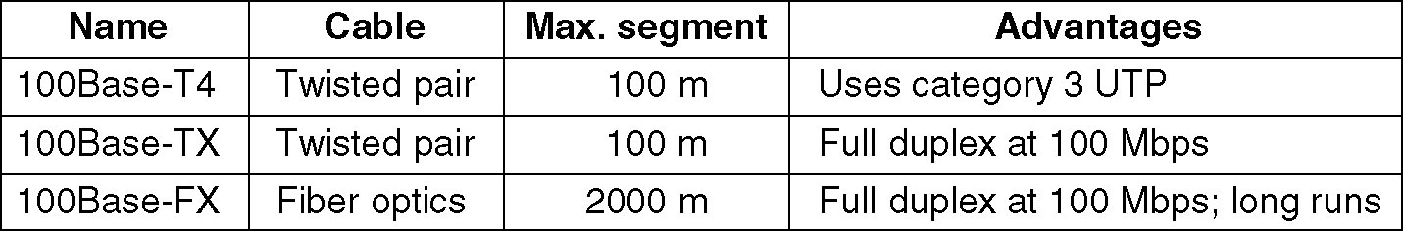
Fast Ethernet
The original fast Ethernet cabling.

Slide 89
Fast Ethernet
100Base-T4
  Used a signaling speed of 25 MHz, faster than standard Ethernet’s 20 MHz.
  Inability to carry 100 Mbps over 100 meters (specified for 10-Mbps hubs)
  To achieve necessary bit rate, requires four twisted pairs

Slide 90
Fast Ethernet
100Base-TX
  Wires can handle clock rates of 125 MHz.
  Only two twisted pairs per station
  4B/5B coding used (No NRZ or Manchester)
  Full duplex

Slide 91
Fast Ethernet
100Base-FX
  Two strands of Multimode fiber, one for each direction
  Full duplex
  Distance between a switch and a station can be up to 2 km.

Slide 92
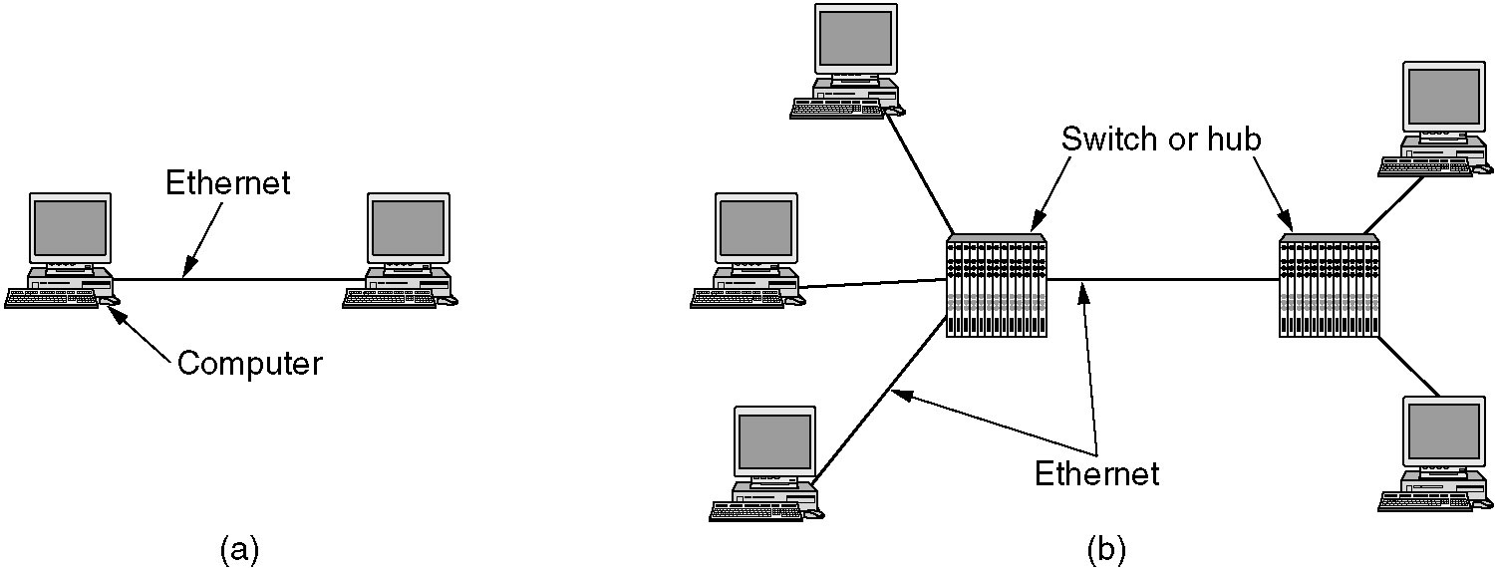
Gigabit Ethernet
Configuration uses point-to-point links
(a) A two-station Ethernet
(b) A multistation Ethernet.

Slide 93
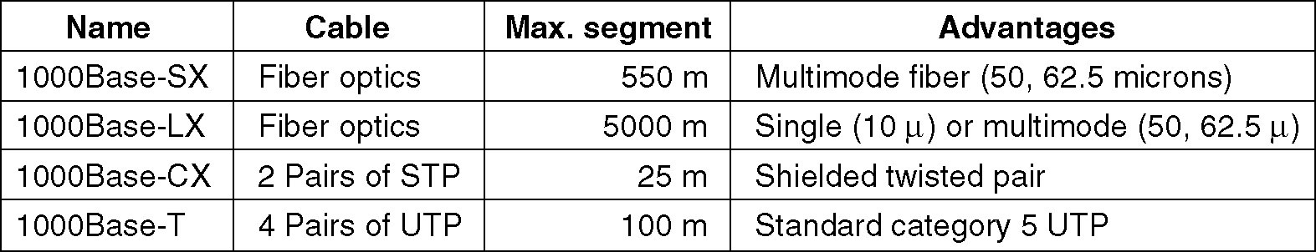
Gigabit Ethernet (2)
Gigabit Ethernet cabling.

Slide 94
Repeaters, Hubs, Bridges , Switches, Routers, and Gateways
Physical layer: Repeaters and Hub
Data link layer: Bridge, Switch
Network Layer: Router
Transport Layer: Transport Gateway
Application Layer: Application Gateway

Slide 95
Reference
Computer Networks, Fifth Edition by Andrew Tanenbaum and David Wetherall, Pearson Education-Prentice Hall, 2011

